Slide 1
Software Testing and Quality Assurance
Theory and Practice
Chapter 7
System Integration Testing
Notes:
Handouts
------------------------------------------------------------------
------------------------------------------------------------------
-------------------------------------------------------------------
--------------------------------------------------------------------

Slide 2
Outline of the Chapter
The Concept of Integration Testing
Different Types of Interfaces
Different Types of Interface Errors
Granularity of System Integration Testing
System Integration Techniques: Incremental, Top-down, Bottom-up, and Sandwich and Big-bang
Software and Hardware Integration
Hardware Design Verification Tests
Hardware and Software Compatibility Matrix
Test Plan for System Integration
Off-the-self Component Integration
Off-the-shelf Component Testing
Built-in Testing
Notes:
Handouts

Slide 3
The Concept of Integration Testing
A software module is a self-contained element of a system
Modules are individually tested commonly known as unit testing
Next major task is to put the modules, i.e., pieces together to construct the complete system
Construction of a working system from the pieces is not a straightforward task because of numerous interface errors
The objective of system integration testing (SIT) is to build a “working” version of the system
  Putting modules together in an incremental manner
  Ensuring that the additional modules work as expected without disturbing the functionalities of the modules already put together
Integration testing is said to be complete when
  The system is fully integrated togethr
  All the test cases have been executed
  All the severe and moderated defects found have been fixed
Notes:
Handouts

Slide 4
The Concept of Integration Testing
The major advantages of conducting SIT are as follows:
Defects are detected early
It is easier to fix defects detected earlier
We get earlier feedback on the health and acceptability of the individual modules and on the overall system
Scheduling of defect fixes is flexible, and it can overlap with development
Notes:
Handouts

Slide 5
Different Types of Interfaces
Three common paradigms for interfacing modules:
Procedure call interface
Shared memory interface
Message passing interface
  The problem arises when we “put modules together” because of interface errors
Interface errors
  Interface errors are those that are associated with structures existing outside the local environment of a module, but which the module uses
Notes:
Handouts

Slide 6
Different Types of Interface Errors
Construction
Inadequate functionality
Location of functionality
Changes in functionality
Added functionality
Misuse of interface
Misunderstanding of interface
Data structure alteration
Inadequate error processing
Additions to error processing
Inadequate post-processing
Inadequate interface support
Initialization/value errors
Validation od data constraints
Timing/performance problems
Coordination changes
Hardware/software interfaces
Notes:
Handouts

Slide 7
Granularity of System Integration Testing
System Integration testing is performed at different levels of granularity
Intra-system testing
  This form of testing constitutes low-level integration testing with the objective of combining the modules together to build a cohesive system
Inter-system testing
  It is a high-level testing phase which requires interfacing independently tested systems
Pairwise testing
  In pairwise integration, only two interconnected systems in an overall system are tested at a time
  The purpose of pairwise testing is to ensure that two systems under consideration can function together, assuming that the other systems within the overall environment behave as expected
Notes:
Handouts

Slide 8
System Integration Techniques
Common approaches to perform system integration testing
Incremental
Top-down
Bottom-up
Sandwich
Big-bang
Pre-requisite
A module must be available to be integrated
  A module is said to available for combining with other modules when the module’s check-in request form is ready
Notes:
Handouts

Slide 9
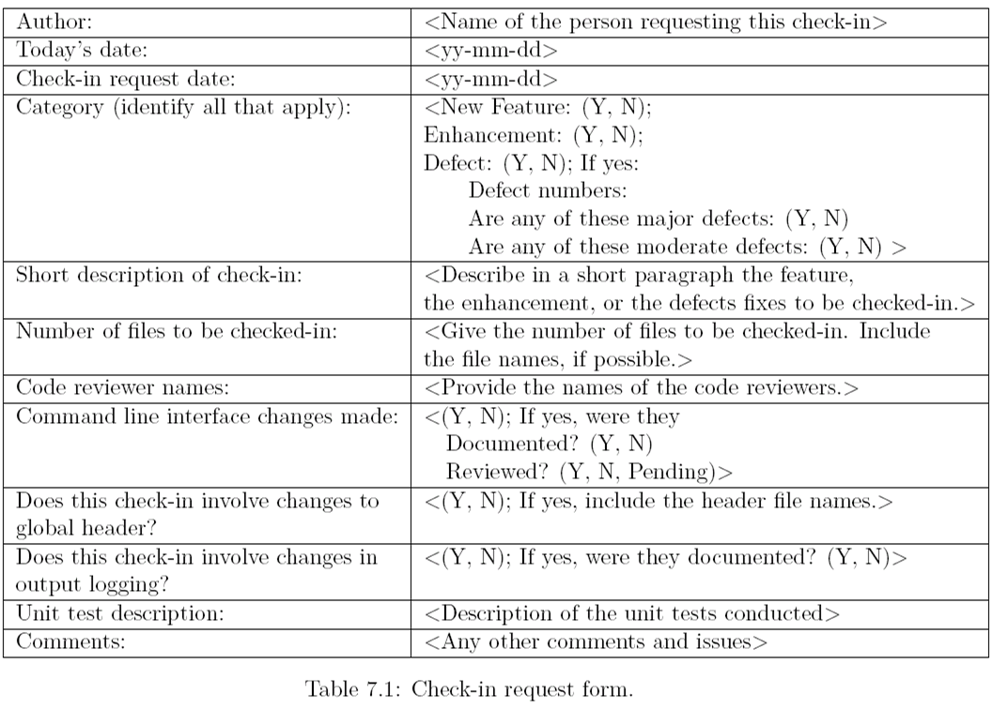
Check-in Request Form
Notes:
Handouts

Slide 10
Incremental
A software image is a compiled software binary
A build is an interim software image for internal testing within an organization
Constructing a build is a process by which individual modules are integrated to form am interim software image.
The final build is a candidate for system testing
Constructing a software image involves the following activities
  Gathering the latest unit tested, authorized versions of modules
  Compiling the source code of those modules
  Checking in the compiled code to the repository
  Linking the compiled modules into subassemblies
  Verifying that the subassemblies are correct
  Exercising version control
Notes:
Handouts

Slide 11
Incremental
Integration testing is conducted in an incremental manner as a series of test cycles
In each test cycle, a few more modules are integrated with an existing and tested build to generated larger builds
The complete system is built, cycle by cycle until the whole system is operational for system-level testing.
The number of SIT cycles and the total integration time are determined by the following parameters:
  Number of modules in the system
  Relative complexity of the module (cyclomatic complexity)
  Relative complexity of the interfaces between the modules
  Number of modules needed to be clustered together in each test cycle
  Whether the modules to be integrated have boon adequately tested before
  Turnaround time for each test-debug-fix cycle
Notes:
Handouts

Slide 12
Incremental
A release note containing the following information accompanies a build.
  What has changed since the last build?
  What outstanding defects have been fixed?
  What are the outstanding defects in the build?
  What new modules, or features, have been added?
  What existing modules, or features, have been enhanced, modified, or deleted?
  Are there any areas where unknown changes may have occurred?
A test strategy is created for each new build and the following issues are addressed while planning a test strategy
  What test cases need to be selected from the SIT test plan?
  What previously failed test cases should now be re-executed in order to test the fixes in the new build?
  How to determine the scope of a partial regression tests?
  What are the estimated time, resource deman, and cost to test this build?
Notes:
Handouts

Slide 13
Incremental
Creating a daily build is very popular among many organization
It facilitates to a faster delivery of the system
It puts emphasis on small incremental testing
It steadily increases number of test cases
The system is tested using automated, re-usable test cases
An effort is made to fix the defects that were found within 24 hours
Prior version of the build are retained for references and rollback
A typical practice is to retain the past 7-10 builds
Notes:
Handouts

Slide 14
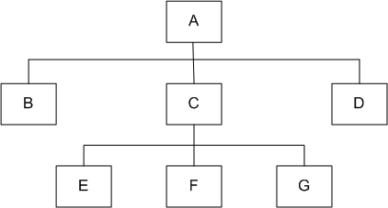
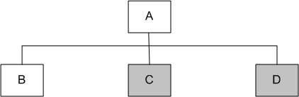
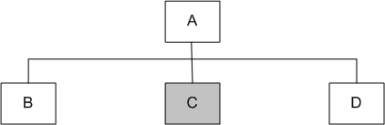
Top-down
Module A has been decomposed into modules B, C, and D
Modules B, D, E, F, and G are terminal modules
First integrate modules A and B using stubs C` and D` (represented by grey boxes)
Next stub D` has been replaced with its actual instance D
Two kinds of tests are performed:
  Test the interface between A and D
  Regression tests to look for interface defects between A and B in the presence of module D
Figure 7.1: A module hierarchy with three levels and seven modules
Figure 7.2: Top-down integration of modules A and B
Figure 7.3: Top-down integration of modules A, B and D
Notes:
Handouts

Slide 15
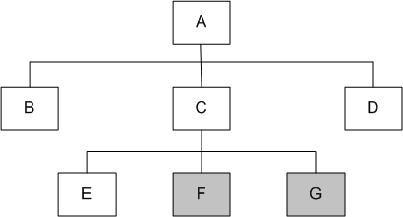
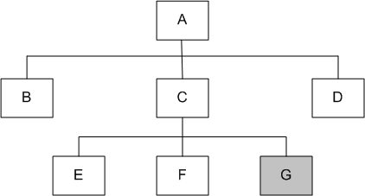
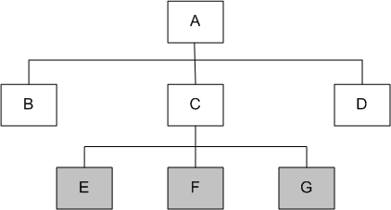
Top-down
Stub C` has been replaced with the actual module C, and new stubs E`, F`, and G`
Perform tests as follows:
  first, test the interface between A and C;
  second, test the combined modules A, B, and D in the presence of C
The rest of the process depicted in the right hand side figures.
Figure 7.5: Top-down integration of modules A, B, C, D and E
Figure 7.6: Top-down integration of modules A, B, C, D, E and F
Figure 7.4: Top-down integration of modules A, B, D and C
Notes:
Handouts

Slide 16
Top-down
Advantages
The SIT engineers continually observe system-level functions as the integration process continue
Isolation of interface errors becomes easier because of the incremental nature of the top-down integration
Test cases designed to test the integration of a module M are reused during the regression tests performed after integrating other modules
Disadvantages
It may not be possible to observe meaningful system functions because of an absence of lower level modules and the presence of stubs.
Test case selection and stub design become increasingly difficult when stubs lie far away from the top-level module.
Notes:
Handouts

Slide 17
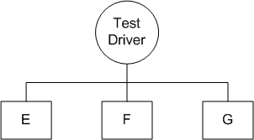
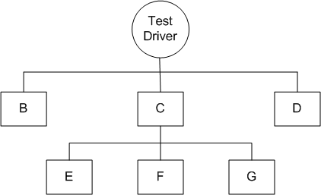
Bottom-up
We design a test driver to integrate lowest-level modules E, F, and G
Return values generated by one module is likely to be used in another module
The test driver mimics module C to integrate E, F, and G in a limited way.
The test driver is replaced with actual module , i.e., C.
A new test driver is used
At this moment, more modules such as B and D are integrated
The new test driver mimics the behavior of module A
Finally, the test driver is replaced with module A and further test are performed
Figure 7.8: Bottom-up integration of module E, F, and G
Figure 7.9: Bottom-up integration of module B, C, and D with F, F, and G
Notes:
Handouts

Slide 18
Bottom-up
Advantages
One designs the behavior of a test driver by simplifying the behavior of the actual module
If the low-level modules and their combined functions are often invoked by other modules, then it is more useful to test them first so that meaningful effective integration of other modules can be done
Disadvantages
Discovery of major faults are detected towards the end of the integration process, because major design decision are embodied in the top-level modules
Test engineers can not observe system-level functions from a partly integrated system. In fact, they can not observe system-level functions until the top-level test driver is in place
Notes:
Handouts

Slide 19
Big-bang and Sandwich
Big-bang Approach
First all the modules are individually tested
Next all those modules are put together to construct the entire system which is tested as a whole
Sandwich Approach
In this approach a system is integrated using a mix of top-down, bottom-up, and big-bang approaches
A hierarchical system is viewed as consisting of three layers
The bottom-up approach is applied to integrate the modules in the bottom-layer
The top layer modules are integrated by using top-down approach
The middle layer is integrated by using the big-bang approach after the top and the bottom layers have been integrated
Notes:
Handouts

Slide 20
Software and Hardware Integration
Integration is often done in an iterative manner
A software image with a minimal number of core modules is loaded on a prototype hardware
A small number of tests are performed to ensure that all the desired software modules are present in the build
Next, additional tests are run to verify the essential functionalities
The process of assembling the build, loading on the target hardware, and testing the build continues until the entire product has been integrated
Notes:
Handouts

Slide 21
Hardware Design Verification Tests
A hardware engineering process consists of four phases
Planning and specification
Design, prototype implementation, and testing
Integration with the software system
Manufacturing, distribution and field service
A hardware Design Verification Test (DVT) plan is prepared and executed by the hardware group before the integration with software system
Notes:
Handouts

Slide 22
Hardware Design Verification Tests
The main hardware tests are aa follows:
Diagnostic Test
Electrostatic Discharge Test
Electromagnetic Emission Test
Electrical Test
Thermal Test
Environment Test
Equipment Handling and Packaging Test
Acoustic Test
Safety Test
Reliability Test
Notes:
Handouts

Slide 23
Hardware and Software Compatibility Matrix
H/W and s/w compatibility information is maintained in the form of a compatibility matrix
It documents different revisions of the h/w and s/w that will be used for official release of the product
An Engineering Change Order (ECO) is a formal document that describes a change to the hardware and software
An ECO document includes the hardware software compatible matrix
It is distributed to the operation, customer support and sales teams of the organization
Notes:
Handouts

Slide 24
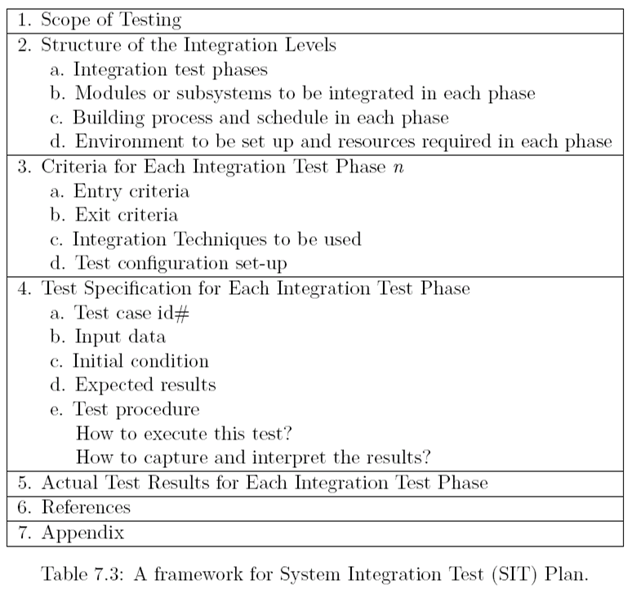
Test Plan for System Integration
Notes:
Handouts

Slide 25
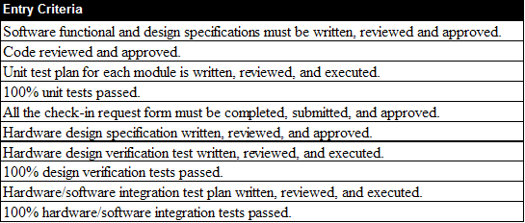
Test Plan for System Integration
Table 7.4: A framework for system integration entry criteria
Notes:
Handouts

Slide 26
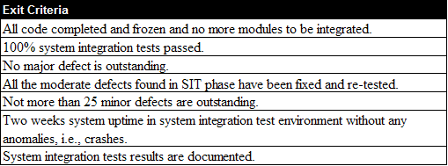
Test Plan for System Integration
Table 7.5: A framework for system integration exit criteria
Notes:
Handouts

Slide 27
Test Plan for System Integration
Categories of System Integration Tests:
Interface integrity
  Internal and external interfaces are tested as each module is integrated
Functional validity
  Tests to uncover functional errors in each module after it is integrated
End-to-end validity
  Tests are designed to ensure that a completely integrated system works together from end-to-end
Pairwise validity
  Tests are designed to ensure that any two systems work properly when connected by a network
Interface stress
  Tests are designed to ensure that the interfaces can sustain the load
System endurance
  Tests are designed to ensure that the integrated system stay up for weeks
Notes:
Handouts

Slide 28
Off-the-self Component Integration
Organization occasionally purchase off-the-self (OTS) components from vendors and integrate them with their own components
Useful set of components that assists in integrating actual components:
Wrapper: It is a piece of code that one builds to isolate the underlying components from other components of the system
Glue: A glue component provides the functionality to combine different components
Tailoring: Components tailoring refers to the ability to enhance the functionality of a component
  Tailoring is done by adding some elements to a component to enrich it with a functionality not provided by the vendor
  Tailoring does not involve modifying the source code of the component
Notes:
Handouts

Slide 29
Off-the-shelf Component Testing
OTS components produced by the vendor organizations are known as commercial off-the-shelf (COTS) components
A COTS component is defined as:
A unit of composition with contractually specified interfaces and explicit context dependencies only. A software component can be deployed independently and is subject to composition by third parties
Three types of testing techniques are use to determine the suitability of a COTS component:
Black-box component testing: This is used to determine the quality of the component
System-level fault injection testing: This is used to determine how well a system will tolerate a failing component
Operational system testing: This kind of tests are used to determine the tolerance of a software system when the COTS component is functioning correctly
Notes:
Handouts

Slide 30
Built-in Testing
Testability is incorporated into software components
Testing and maintenance can be self-contained
  Normal mode
    The built-in test capabilities are transparent to the component user
    The component does not differ from other non-built-in testing enabled components
  Maintenance mode
    The component user can test the component with the help of its built-in testing features
    The component user can invoke the respective methods of the component, which execute the test, evaluate autonomously its results, and output the test summary
Notes:
Handouts

